Slide 1

Welcoming you to Journey into Large Language Models!

Slide 2
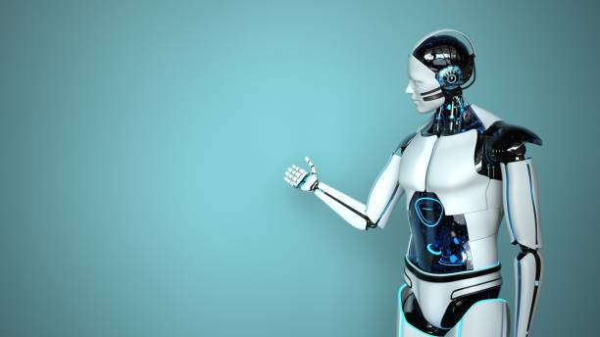
Agenda of this Journey
Session1: Intro to NLP
Session2: NLP Using Deep Learning
Session3: Advanced NLP
Data Preprocessing
Similarities
Word Embeddings
Visualization
GRU, RNN, Types of RNNs, LSTMs , Practical
Transformers, Types of transformers, Transformer Architecture
Session4: Practical
Practical on Finetuning Bert Transformer using Hugging Faces Library

Slide 3
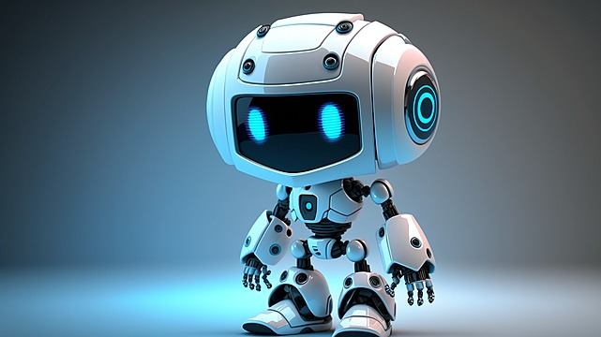
Today’s Agenda
Introduction to NLP
Vectorization/Embeddings.
Cosine Similarity,
Euclidean distance.
Types of text transformations
OneHotEncoding (OHE)
Bag of Words (BOW)
Word2Vec, AvgWord2vec
Data Cleaning
Tokenization
Stopwords removal
Stemming
Lemmatization
Morphological Segmentation
What , Why , How?
Visualization of Word Vectors
Using t-SNE

Slide 4

What is NLP?
Why NLP?
How NLP works?

Slide 5
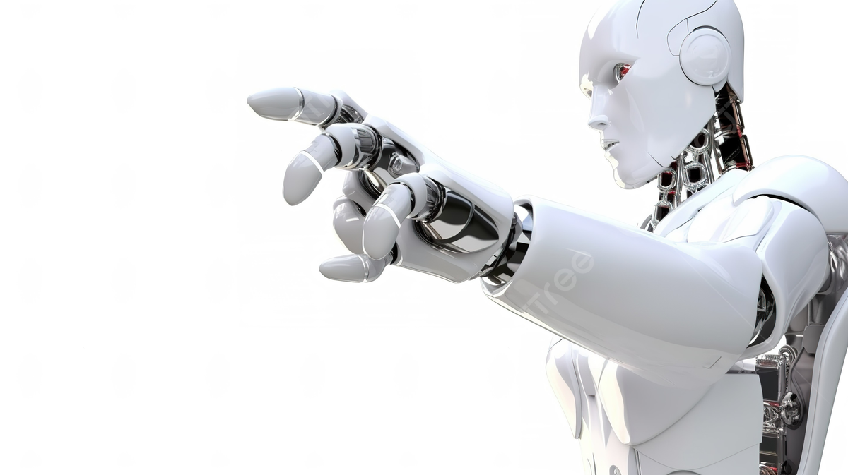
Data Preprocessing
Tokenization : conversion of text into tokens.
Ex : GDSC is a university based community group for students.
LowerCasing:
Ex: SATYA – satya
Stopwords Removal :
Ex: is, a, the, etc.
Stemming: Reducing words to their base or root form by removing suffixes or prefixes.

Slide 6
Data Preprocessing
Lemmatization(Lemma): Reducing words to their base or root form by removing suffixes or prefixes.
Difference?
Ex: I am riding my bicycle to the store..
stem:"I am ride my bicycl to the store."
Lemma:"I be ride my bicycle to the store."
Morphological segmentation.
This divides words into smaller parts called morphemes.
Ex: Untestably - "un," "test," "able" and "ly" as morphemes (useful in lang translation)

Slide 7
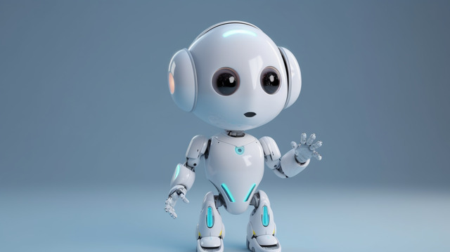
Vectorization/Word Embedding
Frequency/Count Based
OneHotEncoding
Bag of Word
CountVectorizer
Tf-Idf
Glove
Predictive Based
Word2Vec
CBOW
Skip-Gram
AvgWord2Vec

Slide 8
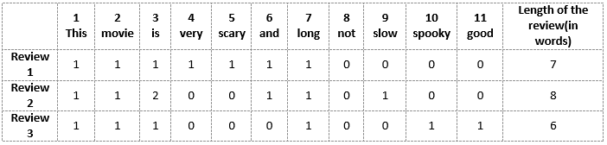
Bag of Words
Link : https://www.analyticsvidhya.com/blog/2020/02/quick-introduction-bag-of-words-bow-tf-idf/
Review 1: This movie is very scary and long
Review 2: This movie is not scary and is slow
Review 3: This movie is spooky and good
Vector of Review 1: [1 1 1 1 1 1 1 0 0 0 0]
Vector of Review 2: [1 1 2 0 0 1 1 0 1 0 0]
Vector of Review 3: [1 1 1 0 0 0 1 0 0 1 1]

Slide 9
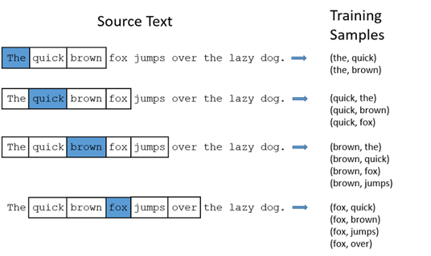
Word2Vec
CBOW

Slide 10
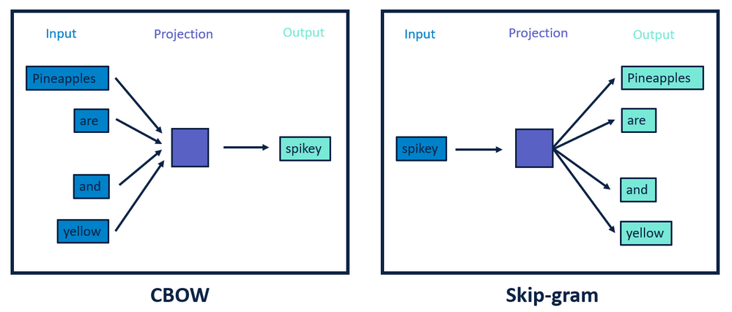
Skip-Gram

Slide 11

It’s fun time…huhu!!

Slide 12
3 men are fishing in their boat when a sudden monster wave sends them all overboard and into the water. Only 1 man got his hair wet. How?

Slide 13
Which word in the dictionary is spelt incorrectly?

Slide 14
Which letter of the alphabet has the most water?

Slide 15
What did the lava say to his girlfriend?

Slide 16
What do you call a guy who’s really loud?

Slide 17
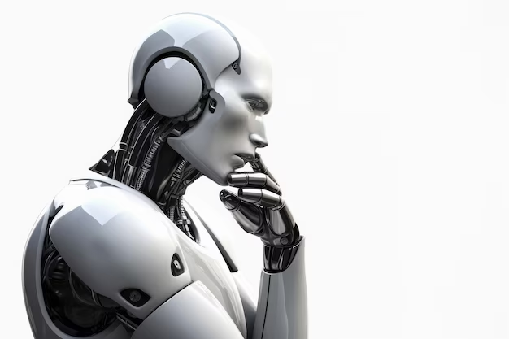
How can machine know two words are similar or not?

Slide 18
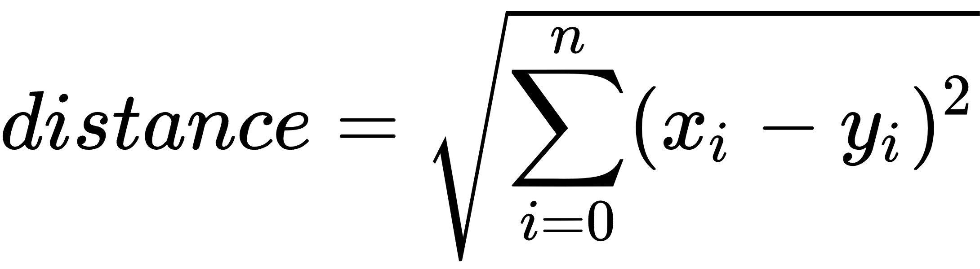
Euclidean Distance

Slide 19
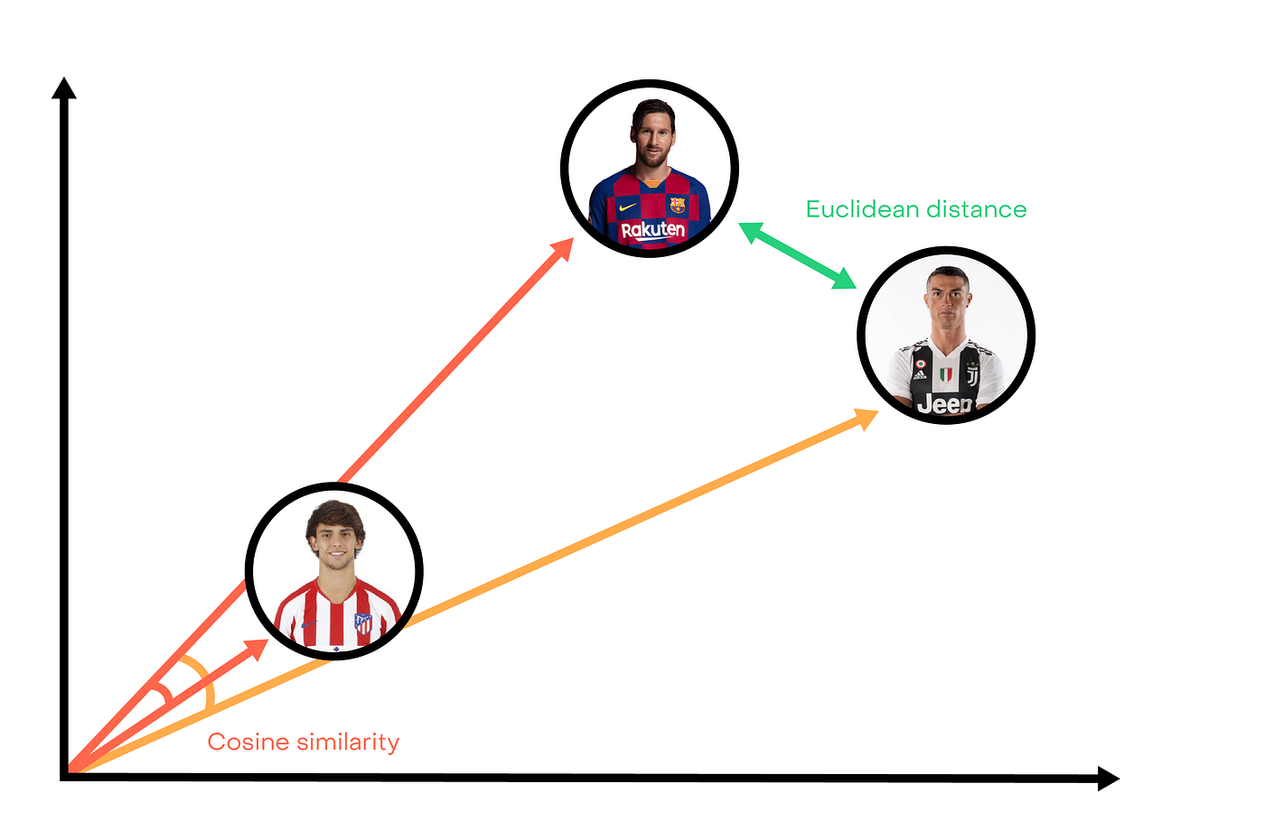
Cosine Similarity: joao Filix

Slide 20
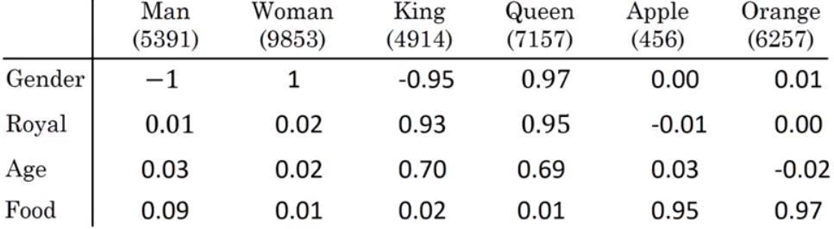
Featurized representation of word embedding
It is interesting to know that King - Man + Woman ≈ Queen!

Slide 21

Enough!! Enough saying!
Can you Visualize and do some practical session??

Slide 22
Questions?

Slide 23
Feedback?
https://forms.gle/TCzWP8mQQ4qpB83r7

Slide 24
Thank You!

